Slide 1
Azure Web Application Hosting, VSTS and DevOps Overview
Questions: brand@microsoft.com

Slide 2
Agenda
DevOps Overview
Building a DevOps pipeline with VSTS
Hosting web applications in Azure

Slide 3
Why DevOps?
Isn’t DevOps another phrase for Agile?
Who is responsible for deploying code?
When deployments fail, who gets blamed?
How many production deployments do you perform per year? Month? Day? Hour?
What is stopping you from deploying faster?

Slide 4


Traditional Development + Operations
DEV
OPS

Slide 5

What is DevOps?
“It’s a job title”
“It’s Development and Operations collaboration”
“It means faster and smaller releases”
“It’s automation”

Slide 6






The DevOps conversation
DEV
OPS
1
People
2
Process
3
Products
Notes:
People = Culture
Fundamental attributes of successful cultures:
Shared mission and incentives: infrastructure as code, apps as services, DevOps/all as teams
You need to consider your hardware as a commodity, (don't give your servers names) , servers are like farm animals, it is just harder if you let theids name them
Build deep instrumentation into services, push complexity up the stack
Rally around agile, shared metrics, CI, service owners on call, etc.
Changing the culture: any change takes time, changing culture is no exception and you can't do it alone, exploit compelling events to change culture: downtimes, cloud adoption, devops buzz
PROCESS Definition and design, compliance, and continuous improvement
PEOPLE Responsibilities, management, skills development, and discipline
Products Tools and infrastructure

Slide 7
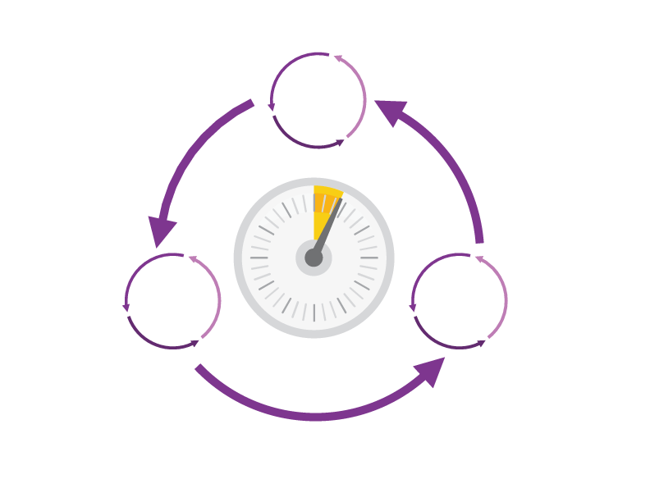
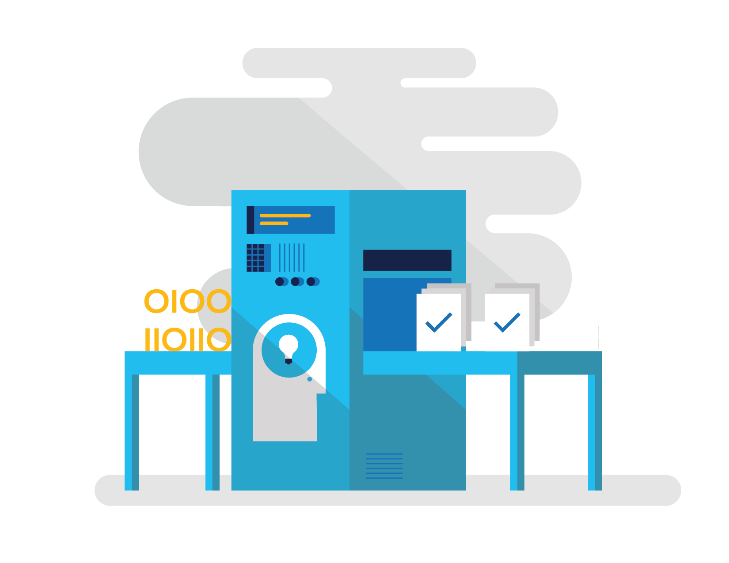
How DevOps can help
Shorten Cycle Times
Optimize Resources
Improve Quality and Availablilty
Speed up and increase traceability of each release by empowering your development and operations teams with advanced collaboration and automation tools.
Efficiently manage environments using technologies that support self-service provisioning in a secure way, in line with your IT governance standards.
Capture rich telemetry on application performance and usage so that you can make better decisions on future investments and anticipate issues in production before they impact your service.

Slide 8
DevOps habits and practices
PRACTICES
Infrastructure as Code
Continuous Deployment
Release Management
Configuration Management
Automated Recovery
PRACTICES
Automated Testing
Continuous Integration
Continuous Deployment
Release Management
PRACTICES
Usage Monitoring
Telemetry Collection Testing in Production
Stakeholder Feedback
PRACTICES
Code Reviews
Automated Testing
Continuous Measurement
FLOW OF CUSTOMER VALUE
TEAM AUTONOMY & ENTERPRISE ALIGNMENT
BACKLOG refined with LEARNING
EVIDENCE gathered in PRODUCTION
MANAGED TECHNICAL DEBT
PRODUCTION FIRST MINDSET
INFRASTRUCTURE is a FLEXIBLE RESOURCE
PRACTICES
Enterprise Agile
Continuous Integration
Continuous Deployment
Release Management
PRACTICES
Testing in Production
Usage Monitoring
User Telemetry
Stakeholder feedback
Feature flags
PRACTICES
Application Performance Management
Infrastructure as Code
Continuous Delivery
Release Management
Automated Recovery

Slide 9
Four focus areas
1
4
Plan
Monitor + Learn
Development
Production
2
3
Develop + Test
Release

Slide 10
Building a DevOps pipeline

Slide 11
Plan + Track
Project starts
Manage work
Develop + Test
1
Track progress
Plan

Slide 12
Plan + Track
Agile planning tools
Governance for development teams
Visualizations through dashboards and charts
Choice of Git or TFVC
Unlimited free private repositories

Slide 13
Develop + Test
2
Write Code
Unit Testing
Version Control
Build
Build Verification
Release

Slide 14



Continuous Integration
Source
Build
Value
Accelerate Delivery
Repeatability
Optimized Resources
Test
Measure
Deployment Lead Time
MTTR
MTTD
DEV
OPS

Slide 15
Continuous Testing
Testing Software
Value
Accelerate Delivery
Repeatability
Optimized Resources
X
Measure
Deployment Lead Time
MTTR
MTTD
DEV
OPS

Slide 16
Building with agents
Custom build agents extend the default Hosted agent
Pool sets of agents to build in parallel
Agent is cross platform
Cross-platform agent runs on-premises or in the cloud

Slide 17
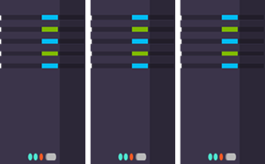
Release
Cloud Load Testing
Integration testing
environment
Staging
environment
3
Monitor + Learn
Automated functional testing environment
Pre-production environment

Slide 18

Continuous Delivery
SOURCE & BUILD
QA ENVIRONMENT
Value
Optimized Resources
Accelerate Delivery
Measure
Deployment Frequency
MTTR
Availability
DEV
OPS

Slide 19
Release Management
SOURCE REPO
DEV
Value
Optimized Resources
Accelerate Delivery
STAGE
Measure
Deployment Frequency
MTTR
Availability
PRODUCTION
DEV
OPS

Slide 20
Infrastructure as Code
DEV
Value
Optimized Resources
Accelerate Delivery
STAGE
Measure
Deployment Rate
MTTR
OPS
PRODUCTION
DEV
OPS

Slide 21
Monitor + Learn
Plan the next iteration
Feedback
Monitor
4

Slide 22
Monitor + Learn
Telemetry at every tier
Performance and load testing
Automated notifications for anomalies

Slide 23
Application Hosting Options
Virtual
Machines
VM
Scale Sets
Container Service
Service Fabric
App Service
Infrastructure as a Service (IaaS)
Platform as a Service (PaaS)

Slide 24


Azure App Service
Web Apps
Mobile Apps
Functions
Web apps that scale with your business
Build Mobile apps for any device
Serverless event
processing
LOGIC Apps
API Apps
Automate business process across SaaS and on-premises
Easily build and consume APIs in the cloud

Slide 25
App Service Plans
Supports the five Azure Web app pricing tiers
Web apps in the same app service plan use same resource hardware
Supports multiple app service plans in a single resource group
Azure Subscription
Datacenter Region
Resource Group
Standard Tier
App Service Plan A
Website A
API A
Free Tier
App Service Plan B
Website B
Notes:
App Service Plans specify the kind of compute resources that your apps run on. If you expect light traffic loads, you can use shared VMs (Free and Shared pricing tiers). For higher loads, you can choose from several sizes of dedicated VMs (Basic, Standard, and Premium tiers). Multiple App Service apps can share the same plan, and they scale up and down the pricing tiers together in the plan.
If you need more scalability and network isolation, you can run your apps in an App Service Environment.

Slide 26

What are Azure Web Apps?
PaaS hosting platform for web workloads
Run on App Service Plans
Web apps run as-is minimal to no changes required
Web Apps
LOGIC Apps
Mobile Apps
Api Apps
Notes:
App Service Web Apps is a fully managed compute platform that is optimized for hosting websites and web applications. This platform-as-a-service (PaaS) offering of Microsoft Azure lets you focus on your business logic while Azure takes care of the infrastructure to run and scale your apps.

Slide 27
What do Azure Web Apps provide?
Multiple languages and frameworks
Support for .NET, Node.js, PHP, Java and Python platforms
Global scale with high availability
Built-in AutoScale and Load Balancing with Auto-Patching features
Connections to SaaS platforms and on-premises data
DevOps optimization
Continuous Deployment with Git, TFS, GitHub
Security and compliance
Visual Studio integration
Notes:
Here are some key features and capabilities of App Service:
Multiple languages and frameworks - App Service has first-class support for ASP.NET, Node.js, Java, PHP, and Python. You can also run Windows PowerShell and other scripts or executables on App Service VMs.
DevOps optimization - Set up continuous integration and deployment with Visual Studio Team Services, GitHub, or BitBucket. Promote updates through test and staging environments. Perform A/B testing. Manage your apps in App Service by using Azure PowerShell or the cross-platform command-line interface (CLI).
Global scale with high availability - Scale up or out manually or automatically. Host your apps anywhere in Microsoft's global datacenter infrastructure, and the App Service SLA promises high availability.
Connections to SaaS platforms and on-premises data - Choose from more than 50 connectors for enterprise systems (such as SAP, Siebel, and Oracle), SaaS services (such as Salesforce and Office 365), and internet services (such as Facebook and Twitter). Access on-premises data using Hybrid Connections and Azure Virtual Networks.
Security and compliance - App Service is ISO, SOC, and PCI compliant.
Application templates - Choose from an extensive list of application templates in the Azure Marketplace that let you use a wizard to install popular open-source software such as WordPress, Joomla, and Drupal.
Visual Studio integration - Dedicated tools in Visual Studio streamline the work of creating, deploying, and debugging.

Slide 28

Supported Deployment Methods
FTP://
Visual Studio Team Services
WebDeploy
DropBox
More…
Notes:
Since you don't have to worry about the web server or application framework, deploying your app to App Service is a matter of deploying your code, binaries, content files, and their respective directory structure, to the /site/wwwroot directory in Azure (or the /site/wwwroot/App_Data/Jobs/ directory for WebJobs). App Service supports the following deployment options:
FTP or FTPS: Use your favorite FTP or FTPS enabled tool to move your files to Azure, from FileZilla to full-featured IDEs like NetBeans. This is strictly a file upload process. No additional services are provided by App Service, such as version control, file structure management, etc.
Kudu (Git/Mercurial or OneDrive/Dropbox): Use the deployment engine in App Service. Push your code to Kudu directly from any repository. Kudu also provides added services whenever code is pushed to it, including version control, package restore, MSBuild, and web hooks for continuous deployment and other automation tasks. The Kudu deployment engine supports 3 different types of deployment sources:
Content sync from OneDrive and Dropbox
Repository-based continuous deployment with auto-sync from GitHub, Bitbucket, and Visual Studio Team Services
Repository-based deployment with manual sync from local Git
Web Deploy: Deploy code to App Service directly from your favorite Microsoft tools such as Visual Studio using the same tooling that automates deployment to IIS servers. This tool supports diff-only deployment, database creation, transforms of connection strings, etc. Web Deploy differs from Kudu in that application binaries are built before they are deployed to Azure. Similar to FTP, no additional services are provided by App Service.
https://azure.microsoft.com/en-us/documentation/articles/web-sites-deploy/

Slide 29
Deployment slots
Swaps staged deployments
Called a Virtual IP or VIP swap as it swaps the addresses of two deployments
No downtime during VIP swap
Sites are warmed up behind the scenes prior to swap

Slide 30
Configuration for Deployment Slots
Settings that are swapped:
General settings - such as framework version, 32-bit / 64-bit, Web sockets
App settings (can be configured to stick to a slot)
Connection strings (can be configured to stick to a slot)
Handler mappings
Monitoring and diagnostic settings
WebJobs content
Settings that are not swapped:
Publishing endpoints
Custom Domain Names
SSL certificates and bindings
Scale settings
WebJobs schedulers
Notes:
When you clone configuration from another deployment slot, the cloned configuration is editable. Furthermore, some configuration elements will follow the content across a swap (not slot specific) while other configuration elements will stay in the same slot after a swap (slot specific)

Slide 31
Demo
Create sample application with CI
Notes:
Open VS
Open VSTS
Create app
Check it in
Enable CI build
Show the dashboard, tasks
Show the build log
Show the build tasks

Slide 32
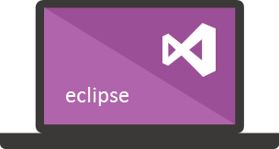



Microsoft Tooling
People | Process | Tools
Developer IDE
Build/CI
Release/CD
Develop
Monitor
Build + Test
Deploy
Team Collaboration
Release Management for Visual Studio
Test
Monitor + Learn
Automation Service
PowerShell | WAML
Azure Resource Management
Application Insights
Microsoft Test Manager
xPlat Command Line

Slide 33



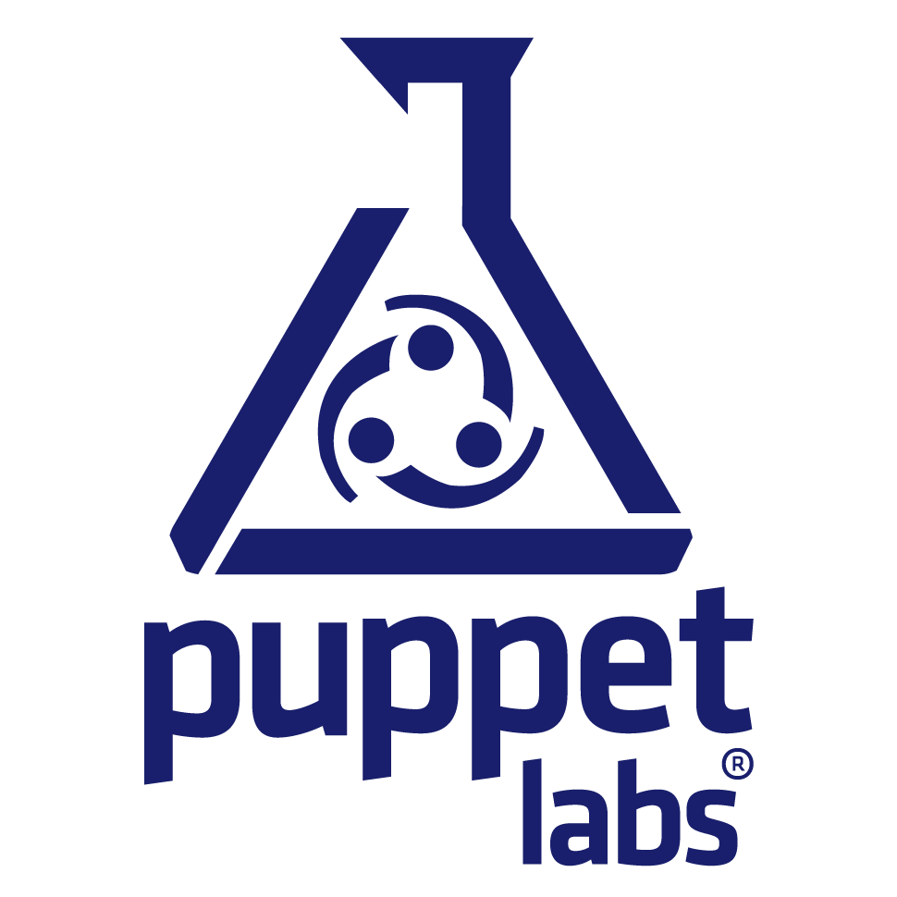







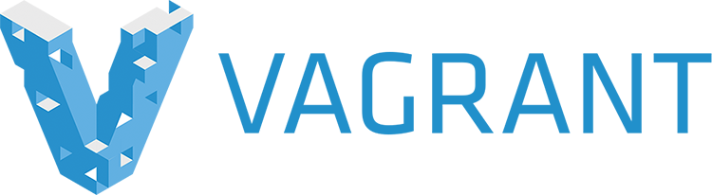
OSS Tooling
People | Process | Tools
Developer IDE
Build/CI
Configuration
Develop
Monitor
Build + Test
Deploy
Team Collaboration
Release
Monitor + Learn
Test

Slide 34
Summary
People, Process, and Tools are equally important
DevOps produces higher quality applications, more quickly, to users of any form factor
Visual Studio Team Services offers a flexible, extensible pipeline spanning from planning to delivery

Slide 35

Questions?

